Slide 1
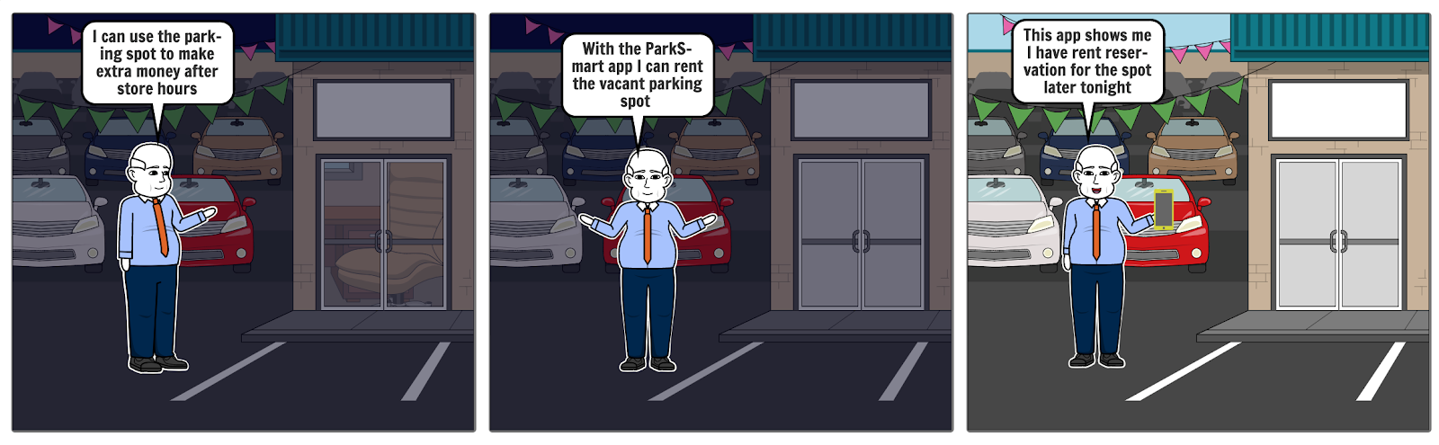

Visual Storyboard Use Case
Mr. Daniel Holden is a grocery store owner and he uses ParkSmart App to list his parking spots on the app and makes extra income.

Slide 2
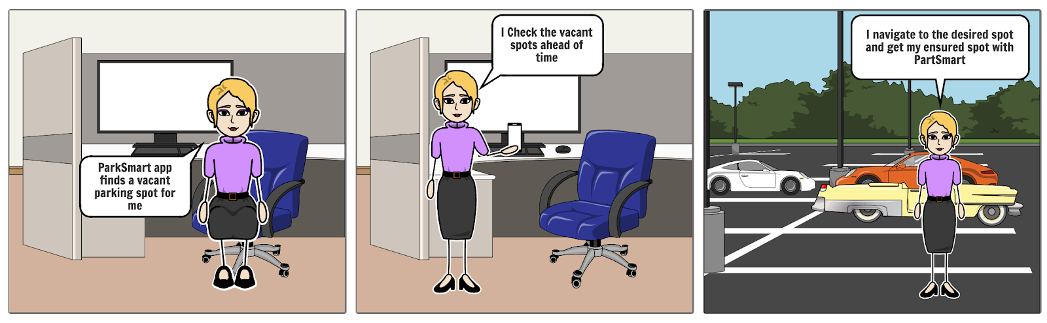
Visual Storyboard Use Case
Samantha Brown is a Program Manager at an IT company. She uses her car for commuting to office. She uses this app to book a spot and park her car at the spot daily.

Slide 3





Product Roadmap
Alpha & Beta Launch
Quarter 1
Quarter 2
Quarter3
Quarter 4
Version release
Beta version
Version 1.0
Version 2.0
Version 3.0.
Version 4.0.
Platform Support
Social Media Integration
Integration with location- based services and utilizing smartphone features
Features
More Sign-Up options, Customer feedbacks, pre-booking
Discounts, new spots, social media analysis
New cities, bike/bicycles options, analytics
All basic functionalities.
Customer Support
Virtual Assistant.
Basic customer support and FAQ’s.
Toll-free number support.
Enhancements.

Slide 4
Product Roadmap
Alpha & Beta Launch
Quarter 1
Quarter 2- version 2.0
Quarter3 – version 3.0
Quarter 4
User Experience
Interactive UI, real-time data
Enhancements, improving search
Partnering with other vendors
Modifying as per newly added features
Marketing
Collaborate with new vendors, referral awards, expansion.
Email campaigns, new offers.
SEO, SMO, Potential parking lot owners.
Loyalty programs, new campaigns.

